Slide 1

Used Smart Phone Price analytics
Reishekesh Reddy Inavola

Slide 2

Background of the Case study
Smartphones have become central to modern life.
Rapid tech advances consumers frequently upgrade phones.
Result: expanding second-hand smartphone market
But: resale market suffers from price inconsistency.
Study uses 3,454 used smartphones, 15 attributes (brand, OS, RAM, camera, battery, etc.)

Slide 3



Business Problems & Impacts
Problem 1: Inconsistent pricing
Sellers struggle to set fair resale prices.
Buyers encounter over/under priced phones.
Impact: seller losses, customer dissatisfaction, reduced trust.
Problem 2: Lack of buyback clarity
Businesses risk overpaying (reduced profit margin) or underpaying (angry customers).
Impact: loss in profits & decline in customer loyalty.
Problem 3: No clear premium vs budget classification
Sellers miss opportunities to charge premium prices for high-end phones.
Buyers uncertain of true phone value.
Impact: missed margins, reduced confidence.

Slide 4

Analytical Approach
Data Preparation:
Checked missing values, zero entries, unrealistic outliers.
Cleaned and imputed values (median imputation for cameras, RAM, battery).
Created new variable: Price Class (High vs Low).
Exploratory Data Analysis (EDA):
Studied distributions of features (screen size, RAM, cameras, battery, etc.).
Built correlation heatmaps identified multicollinearity (battery ~ screen size ~ weight).
Modeling Approach:
Regression predict exact resale price.
Classification group phones into High/Low categories.
Evaluation metrics: RMSE, R², Accuracy, Precision, Recall, F1 Score

Slide 5
Algorithms Chosen
Regression:
Multiple Linear Regression (MLR): interpretable, transparent.
Decision Tree Regression: captures nonlinear relationships, rule-based.
Random Forest Regression: ensemble of trees, accurate, avoids overfitting.
Classification:
Naïve Bayes: works well with categorical data, transparent.
Decision Tree (CART): generates clear if–then rules, interpretable.
Random Forest Classification: accurate, robust, identifies important predictors.
Reason for choice: mix of transparency (MLR, CART) & predictive accuracy (Random Forest).

Slide 6
Models Built
Regression Target Variable: Normalized_used_price
Continuous variable representing resale value.
Classification Target Variable: Price_Class (High = top 30%, Low = bottom 70%).
Key Predictors:
Strong Drivers: normalized_new_price (~0.83 correlation), battery, screen size, RAM, rear/front cameras, release year.
Moderate Impact: days used (negative effect).
Categorical Impact: brand, OS, 4G/5G (brands like Apple & Samsung increase resale value).

Slide 7
Model Performance (Regression)
Multiple Linear Regression (MLR):
R² = 0.82 explains 82% of resale value variation.
RMSE = 0.25 small average error.
Transparent, interpretable but struggles with nonlinearities.
Decision Tree Regression:
R² = 0.76, RMSE = 0.29.
Provides clear pricing rules, but less accurate.
Random Forest Regression:
R² = 0.86, RMSE = 0.22.
Most accurate, robust to multicollinearity.
Downside: less interpretable than MLR or decision tree.

Slide 8
Model Performance (Classification)
Decision Tree Classification (CART):
Accuracy = 90.2%
Sensitivity (High-price phones correctly identified) = 80.6%
Specificity (Low-price phones correctly identified) = 92.1%
Clear if–then rules - very interpretable.
Random Forest Classification:
Accuracy = 89.6%
High specificity (92.5%) but lower sensitivity (73.8%).
Strong accuracy but less transparent.
Naïve Bayes:
Accuracy = 85.2%
Sensitivity = 74.3%
Specificity = 89.8%
Transparent, explains feature contributions.
Weaker performance, misses some high-price phones.

Slide 9
Best Model Selection
Regression Choice: Random Forest Regression
Highest accuracy (R² = 0.86, RMSE = 0.22).
Captures complex feature interactions.
Useful for reliable resale value predictions.
Classification Choice: Decision Tree (CART)
Balanced accuracy + interpretability.
Business can trace clear rules (normalized_new_price ≥ 5.51 AND internal_memory ≥ 48).
Combined Benefit:
Regression for precise pricing and emphasis on important variable for trade ins.
Classification for clear segmentation.

Slide 10
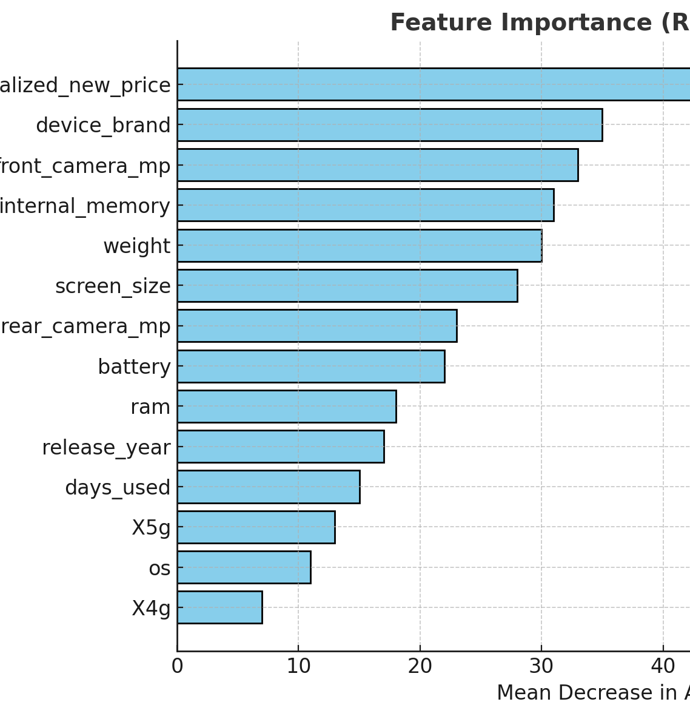
Insights
Decision Tree Classification
IF-THEN RULE
IF normalized_new_price ≥ 5.517794 AND internal_memory ≥ 48 then Premium segment (high)
IF normalized_new_price ≥ 5.517794 AND internal_memory < 48 AND weight ≥ 473 then Premium segment (high)

Slide 11
Questions
Thank you

